Slide 1

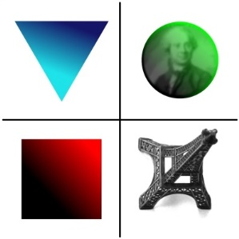


Cohesive zone Finite Element model for large scale yielding in fatigue
Anubhav Roy
CNRS (UMR 7190) Sorbonne University
aroy_esm@psu.edu anubhav.roy@dalembert.upmc.fr

Slide 2
Motivation: establish a multi-scale bridge.
MACRO
MICRO

Slide 3
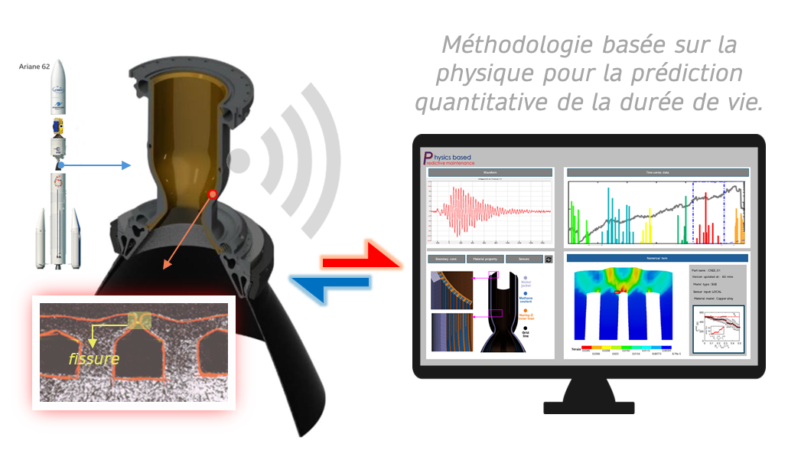
We leverage physics-based methods for residual lifetime prediction of critical components.
3

Slide 4

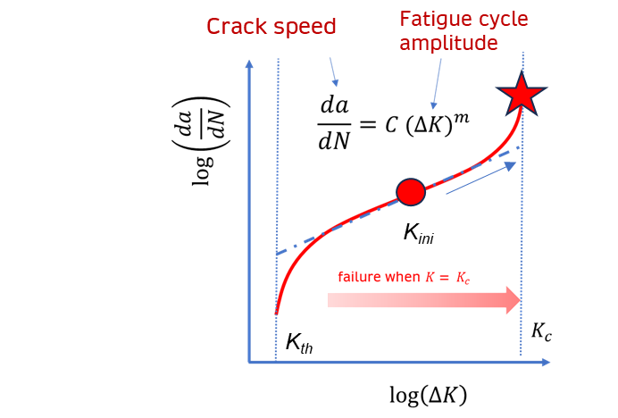
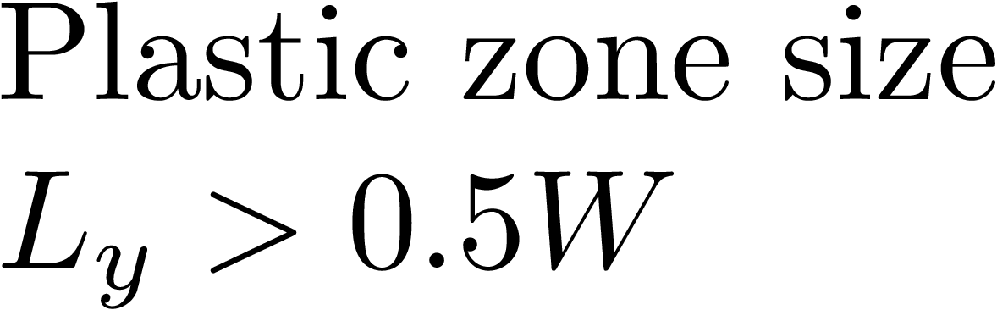

However, there are open questions.
Criterion:
W: Structural Size
Problem:
Linear Elastic Fracture Mechanics (LEFM) breakdown.
4

Slide 5

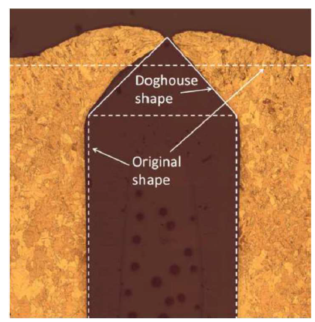
Objective: Investigate the doghouse shape within the walls of combustion chambers of CNES space shuttles subjected to fatigue.
Specification for the fracture test:
Wall specimens containing a crack subjected to Mode–I fatigue
Number of Wall Specimens: 8

Slide 6
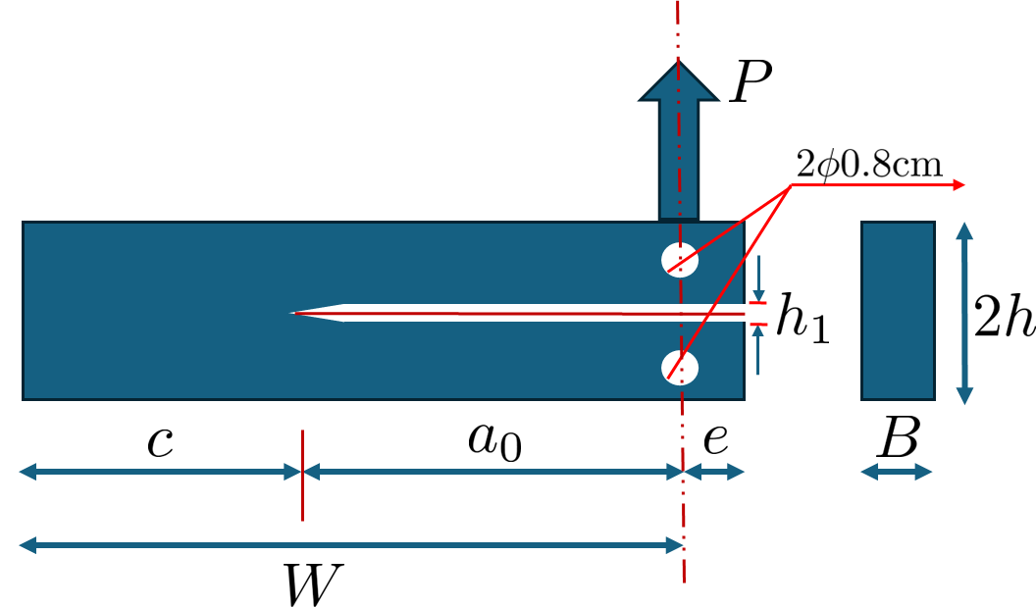

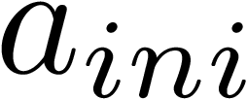
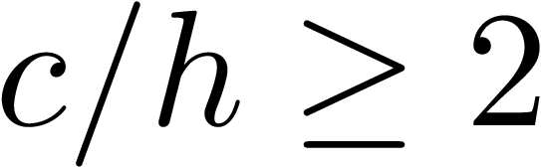
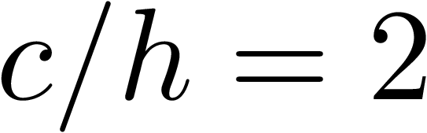
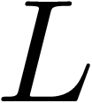
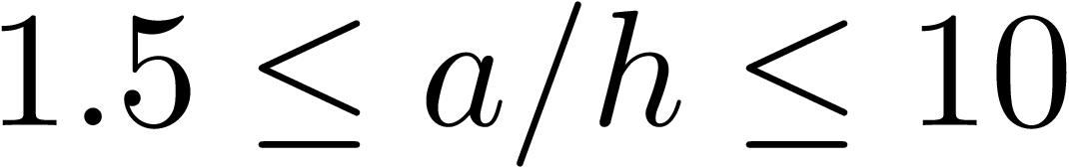
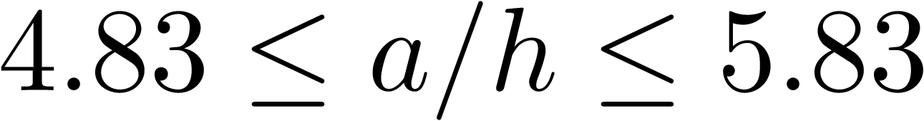
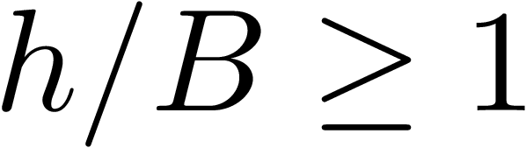
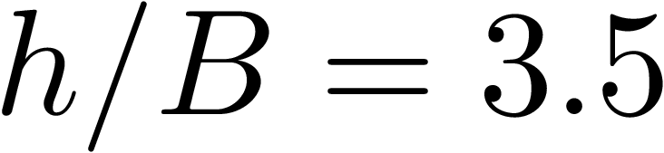
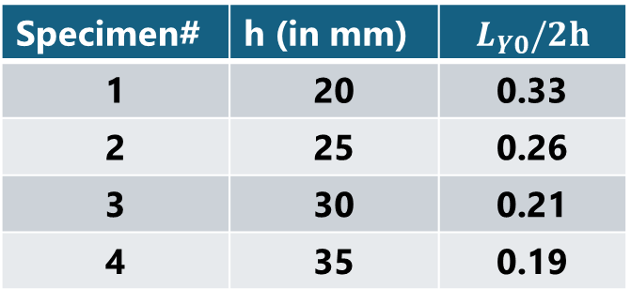
The effects of the length scale on the failure of CuCrZr are numerically investigated using Finite Element modelling.
Specimen# | h (in mm) | $$L_{Y0}/2h$$
1 | 20 | 0.33
2 | 25 | 0.26
3 | 30 | 0.21
4 | 35 | 0.19
Conditions * :
Model Dimensions:
*Li, Z., 1996. A new technique for determining fracture toughness KIC and its confidence with single DCB specimen. Engineering fracture mechanics, 55(1), pp.133-137.

Slide 7
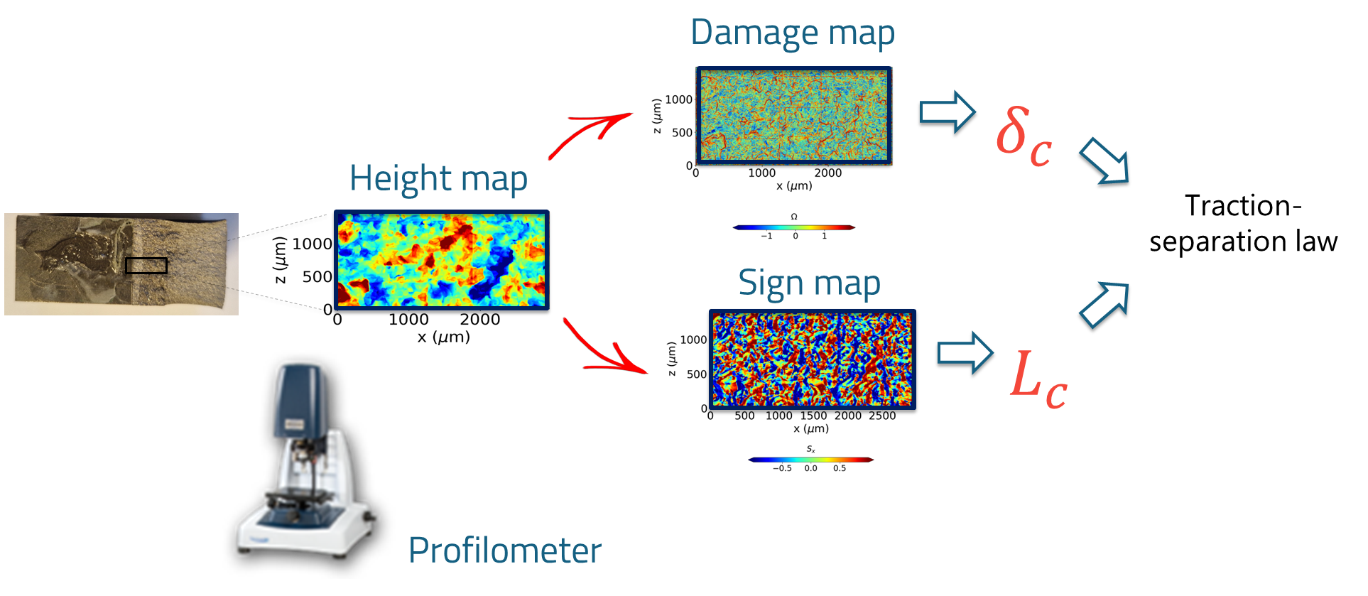
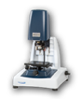
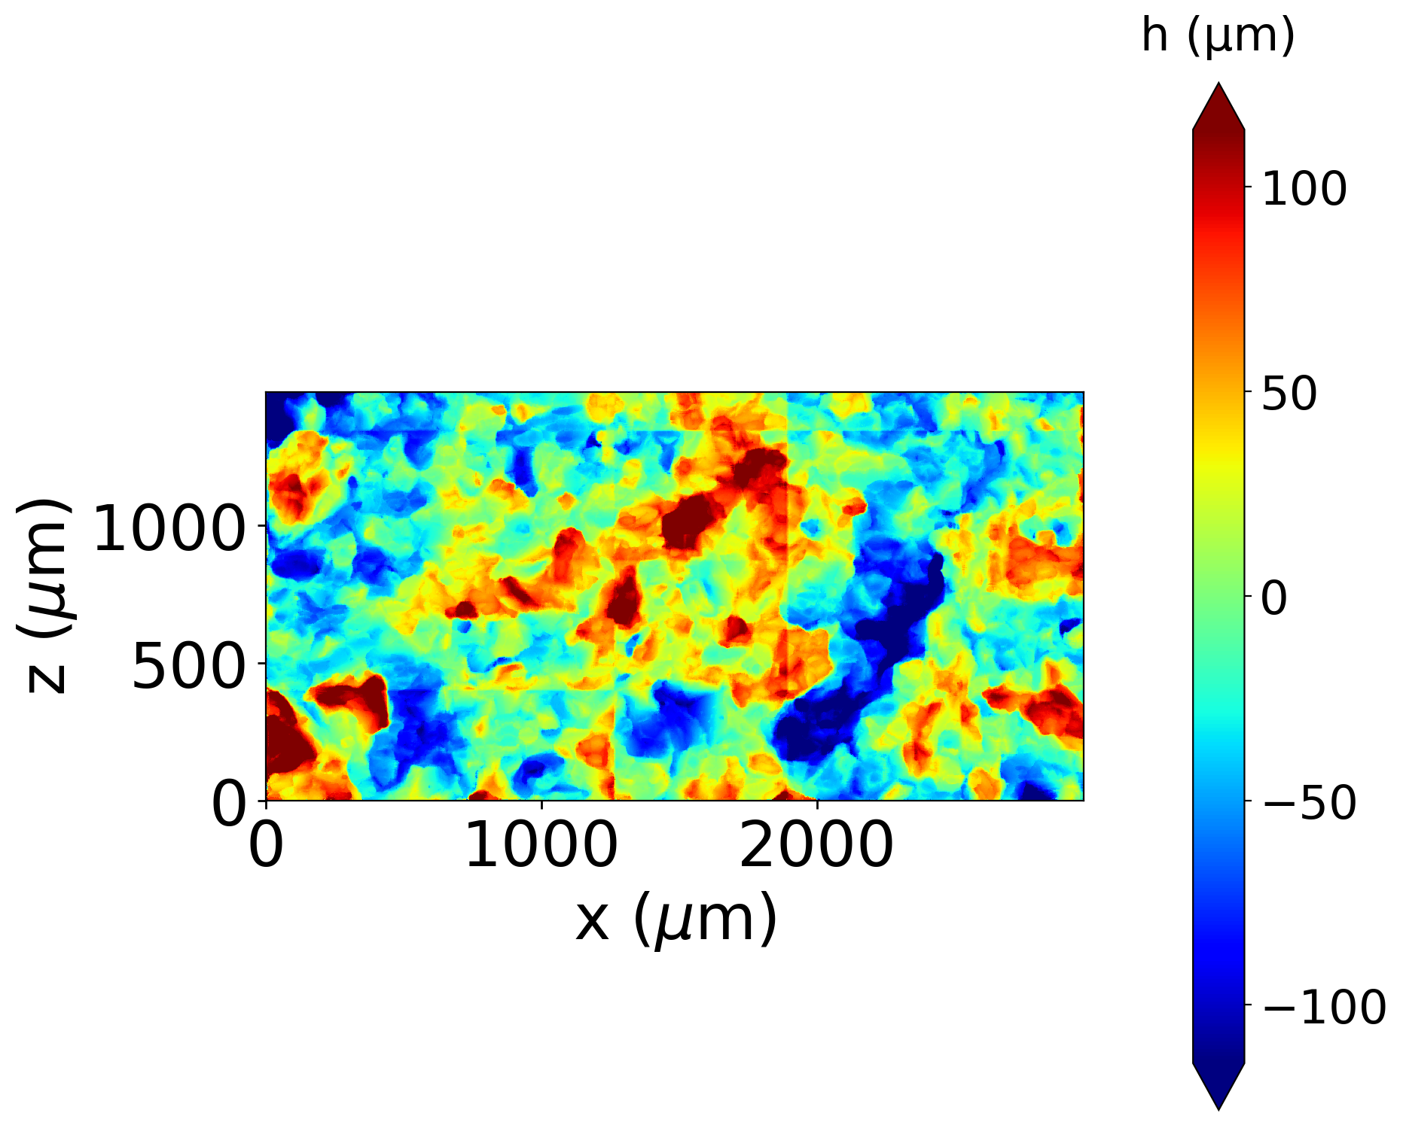
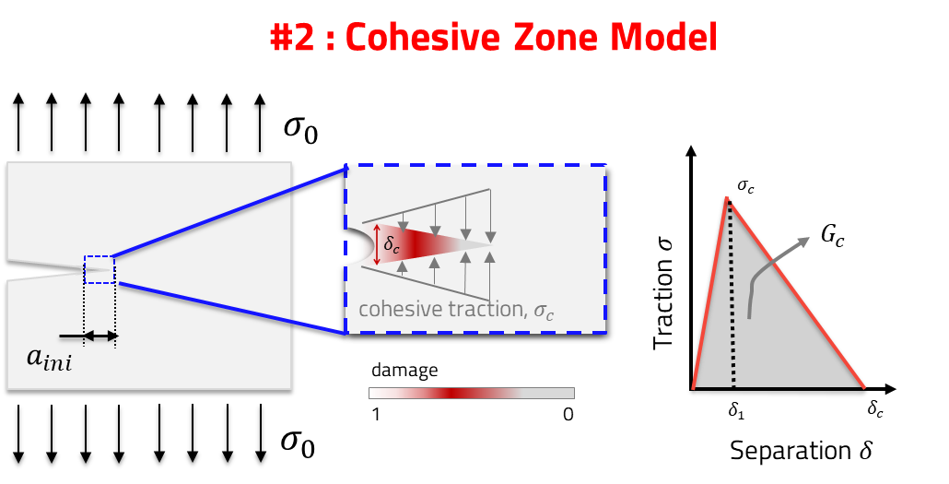

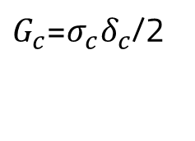




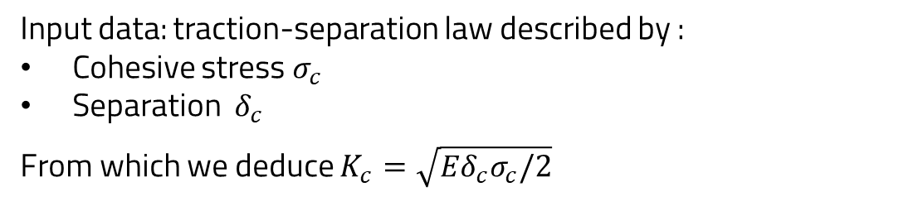
The cohesive traction separation law is validated and used for the elastoplastic scenario.
Materials have finite load bearing capacity
Input data: traction-separation law described by :
Cohesive stress $σ_{c}$
Separation $δ_{c}$
From which we deduce $K_{c}=\sqrt{{{Eδ}_{c}σ}_{c}/2}$
}
measured by
statistical fractography
Force vs Displacement

Slide 8
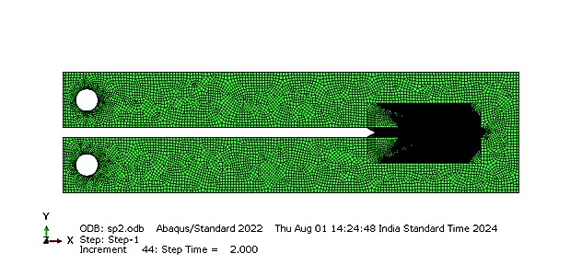
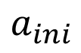
A cohesive zone model has been developed in Finite Elements.
L
$$a_{ini}$$
Cohesive Zone
2h

Slide 9
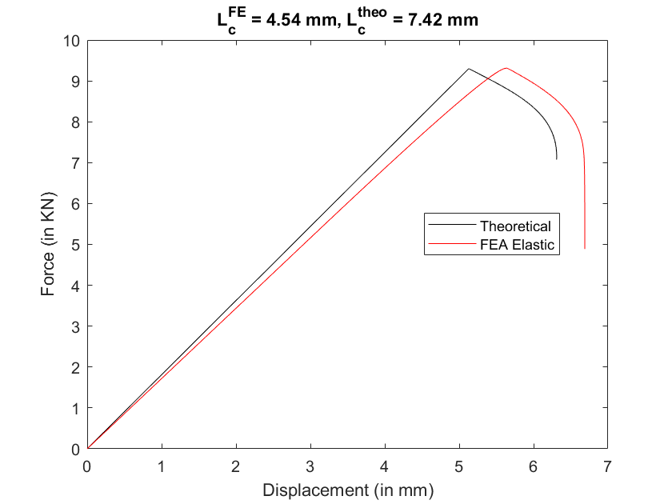
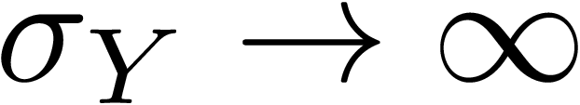
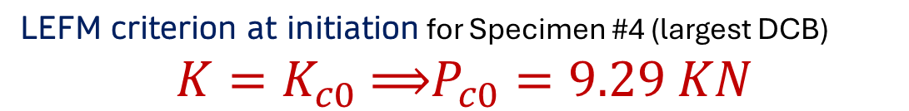
Validation: A reasonably good agreement with theory validates the numerical simulations for brittle versions across sizes.
Specimen #4
LEFM criterion at initiation for Specimen #4 (largest DCB) $$K=K_{c0} \text{⟹}P_{c0}=9.29 KN$$
Kanninen‘s* K vs a model for DCB
*Li, Z. (2014). A new technique for determining fracture toughness $K_{IC}$ and its confidence with single DCB specimen. Engineering fracture mechanics, 55(1), pp.133-137.
*Kanninen, M.F. (1973). An augmented double cantilever beam model for studying crack propagation and arrest. International Journal of Fracture, 9, pp. 83 - 92.

Slide 10
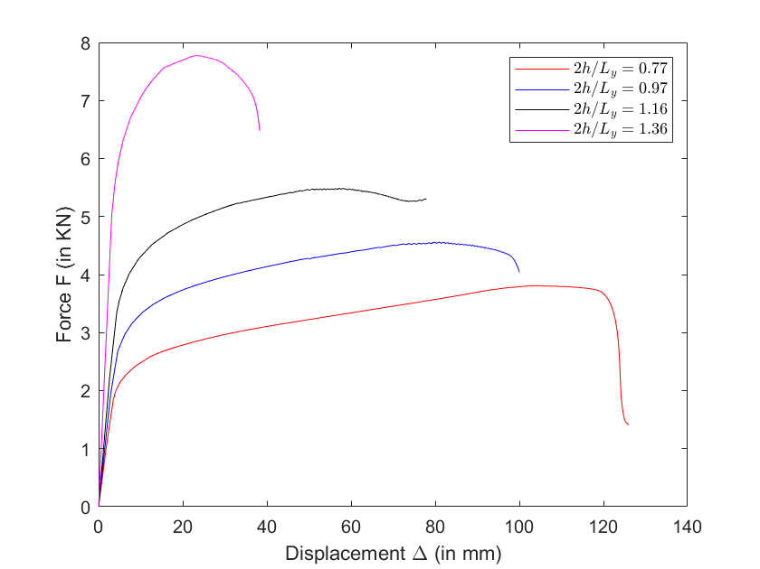
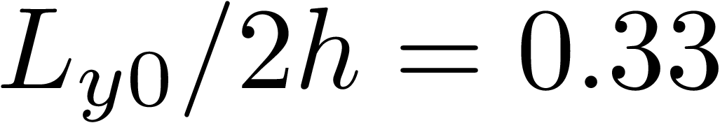
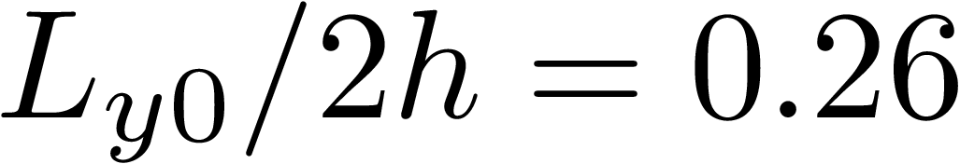
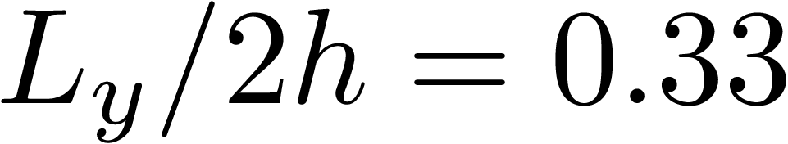
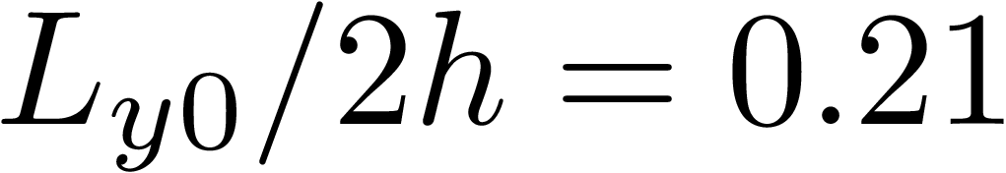
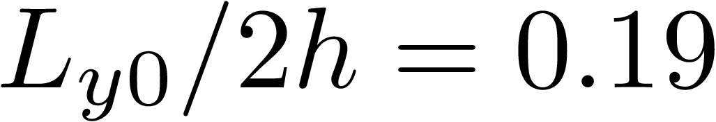


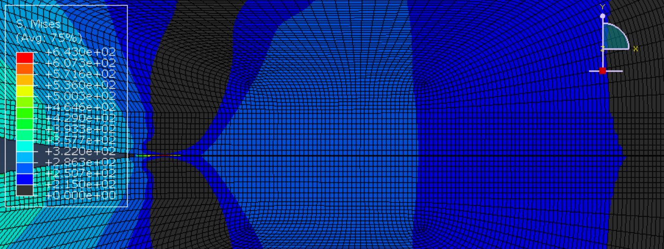
Result #1: The effects of the length scale on the failure of CuCrZr are numerically studied across specimen sizes.

Slide 11
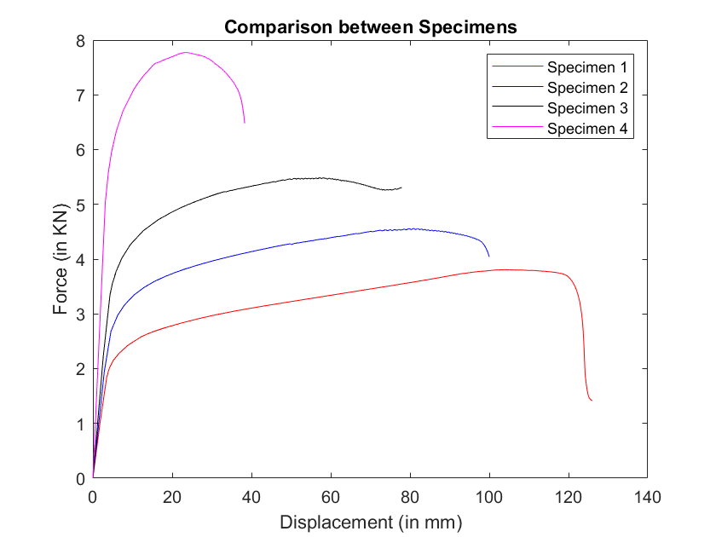
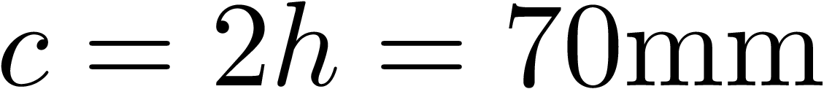




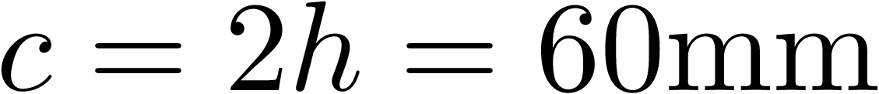


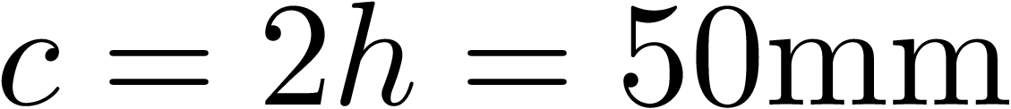

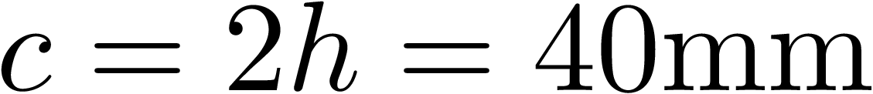
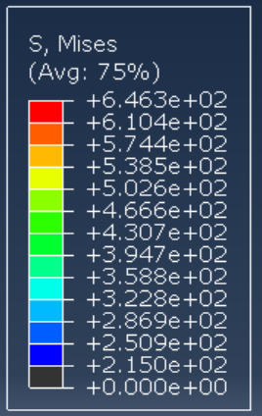


Results for #1: Distribution of the Von Mises Stress ahead of the crack tip for different specimens.

Slide 12

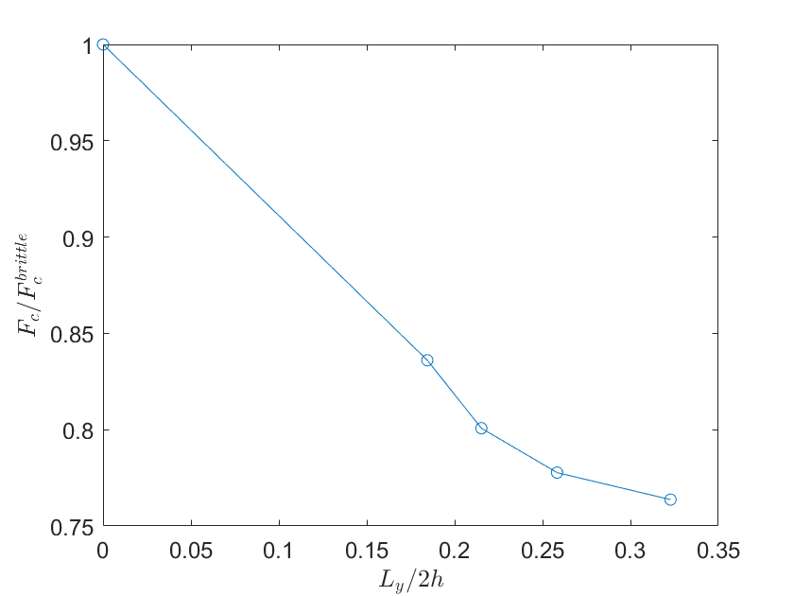
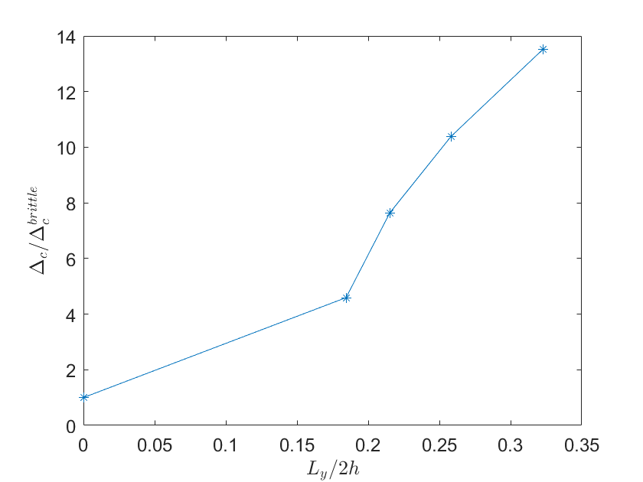
Task #1: The effects of confined plasticity are studied for peak force and peak displacements as a ratio to the brittle scenario.

Slide 13

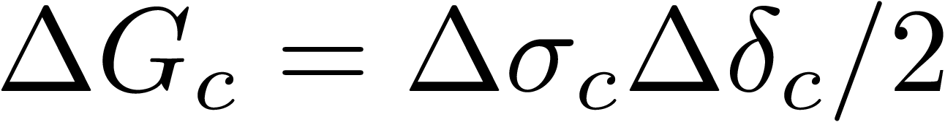
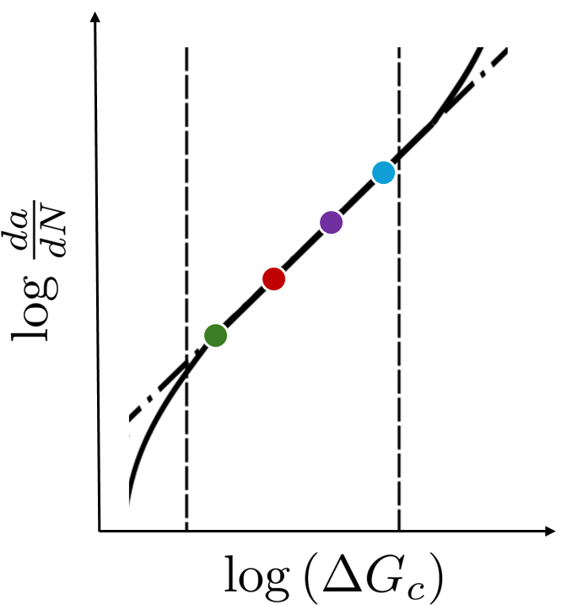
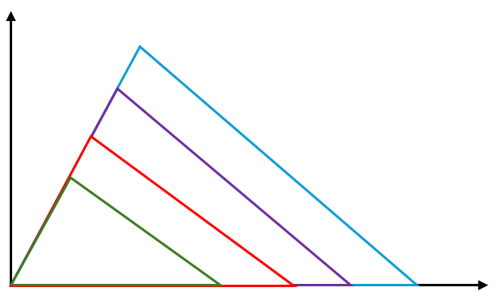
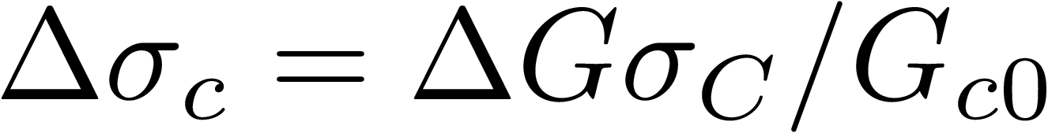

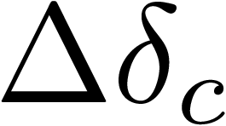
Task #2: A scheme is designed to develop a bridge between points along the Paris Law and elastoplastic CZM.

Slide 14
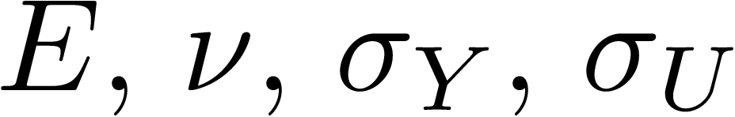
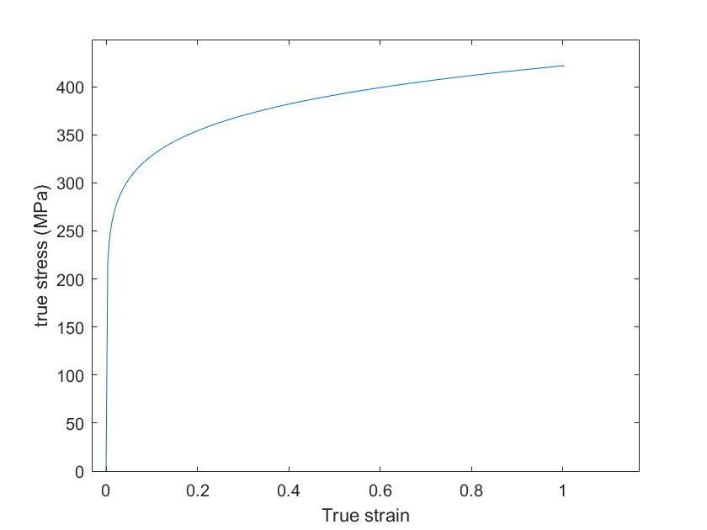
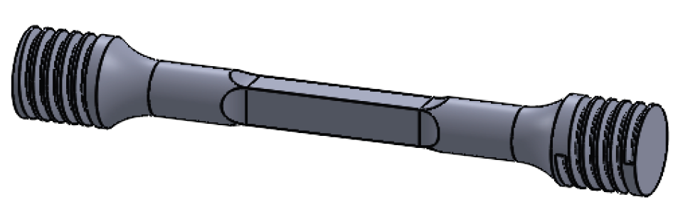
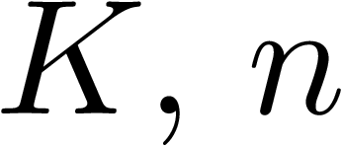

Step #1: Material characterization of the additively manufactured CuCrZr through uniaxial tensile testing of KBr specimens.
Extract elasticity parameters :
Establish Ramberg-Osgood parameters :

Slide 15




Step #2: Catastrophic failure of the largest sample, Specimen 4 Sample 1 (Sp4.1) under monotonic loading.

Slide 16





Goals for Step #2: Measure force-displacement behavior and perform statistical fractography.
DIC: instantaneous crack length a
Estimate Gc

Slide 17

Step #3: Characterize C, m for Paris Law through low cycle fatigue.

Slide 18



Step #4: Run FE simulations (with updated ) to prepare test protocols.

Slide 19



Step #4 Idea: Visualizing fatigue as a series of monotonic loadings.

Slide 20









Step #4 Idea: Visualizing fatigue as a series of monotonic loadings.

Slide 21




Protocol for Copper*
*Seifi, R. and Hosseini, R., 2018. Experimental study of fatigue crack growth in raw and annealed pure copper with considering cyclic plastic effects. Theoretical and Applied Fracture Mechanics, 94, pp.1-9.
21

Slide 22


Slide 23





Slide 24




Slide 25




Slide 26




Slide 27




Slide 28




Slide 29






Results for Copper
Protocol
1 | 0.17 | 1/6 | 1.55 | 0.94 | 8826306 | 0
2 | 0.33 | 0.33 | 3.1 | 1.87 | 460671 | 0
3 | 0.5 | 0.5 | 4.6 | 2.8 | 81892 | 3.15
4 | 0.67 | 0.67 | 5.97 | 4.95 | 24043 | 10
5 | 0.83 | 0.83 | 6.89 | 9.63 | 9293 | 17.98
6 | 1 | 1 | 7.75 | 23.08 | 4274 | 26.68

